Slide 1
Improving lexical diversity of domain-specific automatic text generation with out-of-domain training data and style conditioning
Mina Shahmoradi
Supervisor: Okko Räsänen
Notes:
Name
Thesis subject
supervisor

Slide 2
Table of content
Basis of the thesis
Research questions
Pipeline
    Datasets
    Tokenizer
    Language model
    Text generation
    Analysis of Data
    Pipeline overview
    Incorporating style conditioning
Results

Slide 3
Basis of the thesis
Child-directed speech (CDS) is a special speaking style that supports infants’ language acquisition.
There are no comprehensive datasets to simulate realistic, age-appropriate CDS to run computer simulations of infant language acquisition.
Räsänen & Kocharov (2024)[1]: A transformer-based language model (LM) for stochastic generation of age-appropriate CDS.
  Trained on real CDS transcripts from infant-caregiver interactions.
  Produces realistic CDS, except vocabulary is smaller compared to real CDS data.

Slide 4
Research Questions
Research question 1: Can we improve generated CDS lexical diversity by adding out-of-domain training data, and without compromising other qualities of the data?
Research question 2: How to control style of the generated texts if the expanded LM training data consists of multiple styles (domains)?

Slide 5
Pipeline - Data
Data
Tokenizer
Language model
Text generation
Analysis of results
Child Directed Speech (CDS)
Transcribed text of CHILDES-AO [2]
Child age quantized to 3-month age bins [3, 6, …, 84]
3.82 million word tokens
and 862 992 utterances
Children Book Texts (CBT)
188 children’s books from Project Gutenberg [3]
No target child age information
5.26 million word tokens
and 785 450 sentences

Slide 6
Pipeline - Tokenizer
Data
Tokenizer
Language model
Text generation
Analysis of results
Tokenization: split text into words or sub-word units.
BERT word-piece tokenizer [4]
Codebook of 8000 tokens
+ reserved tokens
Lower-cased input data
input
It is unbelievable.
word-piece tokenizer
[S-PAD]
it
is
un
believ
able
.
[E-PAD]
output

Slide 7
Pipeline – Language model
Data
Tokenizer
Language model
Text generation
Analysis of results
A Transformer-based language model [5]
  Trained for next-token prediction using the preceding context.
  Recipient age conditioning with a separate input.
  Token and position embeddings
  Self-attention layers
  Feed-forward layers
  Causal masking to implement temporal prediction
  A GPT-2.5 -type decoder-only structure

Slide 8
Pipeline – Text generation
Data
Tokenizer
Language model
Text generation
Analysis of results
Structured text generation
Randomized prompt sequences sampled from training data (based on preferred age and style)
Top-k sampling from the prediction distribution.
De-tokenization
Text cleaning step
Next possible token
Probability
context
account
= 0.3
it
is
un
notice
= 0.2
P(token|context)
believable
= 0.49
un
=0.01

Slide 9
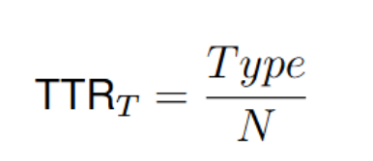

Pipeline – Analysis of results
Data
Tokenizer
Language model
Text generation
Analysis of results
Lexical and syntactic analysis:
  Type-to-token ratio (TTR) [6]
  LM Perplexity [7]
Memorization test (ensure that new content is generated)
Manual qualitative analysis (sanity check)
  Utterance length
  Complex sentence rate
  Dependencies per root
  Part-of-speech rates (nouns, verbs, pronouns, adjectives and interjections)

Slide 10
Pipeline overview
Analysis
Memorization test
Statistical analysis
Manual qualitative analysis
Age factor
Styled
generated CDS
LM
CDS
LM
Styled
generated CBT
CBT
Styling factor
Simulating factors
LM training
Text generation

Slide 11
Pipeline – Incorporating style conditioning
Need to choose whether CDS or CBT is generated. To the right is the data structure of Räsänen & Kocharov (2024)[1]:
Compared approaches:
S1: Add a special style token (”special word”) in front of each text input.
S2: Use a separate model input for style (0/1), mapped to an embedding with a learnable layer, and concatenated in front of word token embeddings.
S3: Combine style information with age-conditioning by using unused age bin for the books.
Dense layer
Transformer layer
Embedding layer
A
text
is
here

Slide 12
Pipeline – Incorporating style conditioning
Need to choose whether CDS or CBT is generated.
Compared approaches:
S1: Add a special style token (”special word”) in front of each text input.
S2: Use a separate model input for style (0/1), mapped to an embedding with a learnable layer, and concatenated in front of word token embeddings.
S3: Combine style information with age-conditioning by using unused age bin for the books.
Dense layer
Transformer layer
Embedding layer
A
S
text
is
here

Slide 13
Pipeline – Incorporating style conditioning
Need to choose whether CDS CBT is generated.
Compared approaches:
S1: Add a special style token (”special word”) in front of each text input.
S2: Use a separate model input for style (0/1), mapped to an embedding with a learnable layer, and concatenated in front of word token embeddings.
S3: Combine style information with age-conditioning by using unused age bin for the books.
Dense layer
Dense layer
Transformer layer
Embedding layer
A
S
text
is
here

Slide 14
Pipeline – Incorporating style conditioning
Need to choose whether CDS or CBT is generated.
Compared approaches:
S1: Add a special style token (”special word”) in front of each text input.
S2: Use a separate model input for style (0/1), mapped to an embedding with a learnable layer, and concatenated in front of word token embeddings.
S3: Combine style information with age-conditioning by using unused age bin for the books.
Dense layer
Transformer layer
Embedding layer
A
text
is
here
S

Slide 15
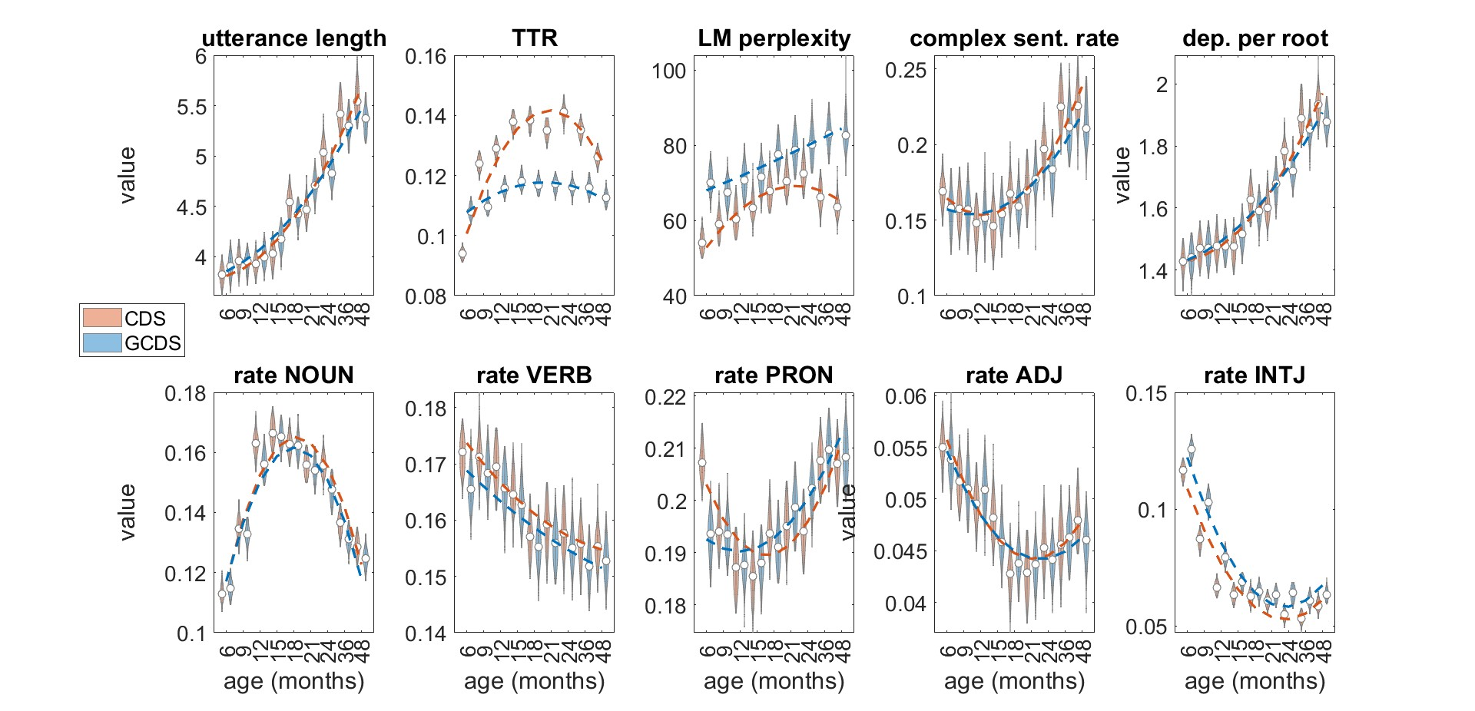
Results – Comparing datasets CDS VS GCDS
TTR needs to be improved.
CDS - 21 month: “you like that word. belly belly. what's that. no that's not Daddy. what is it. that's a squirrel and what is the squirrel eating. that's right. cherries. Eric likes cherries too. I'm going to spray the room in a second. what. yes rabbit.”
GCDS - 21 month: “she can jump though. i'll leave it. alright where's her girl. you say hi. she's sitting in my lap i have to draw something else now. alright. she's sitting on the slide. okay we'll put all this stuff away. oh oh. look. there it is. you have to wash your hair because you're so funny. who are you. wait a minute let's put all these toys away. thank you. whats this.”
Notes:
Now, let check the datasets first to have an understanding how the results is desired to be
Sample of CDS and generated CDS of 21 months old is given on the left
From the plots
TTR needs to be improved while rest of the metrics does not get worse
In this plot you see this violin plots, which shows variation of these metrics through out one age group,
this means for example in pronoun rate although there is some differences to be observed by the general outline btw cds and generated cds,
the overlapping values are a lot as well.
This trend is happening in many of the other metrics similarly.

Slide 16
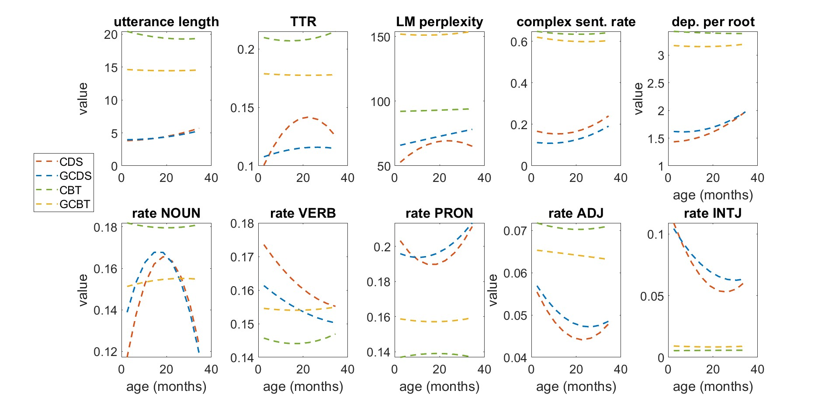
Results – Comparing datasets
GCBT is age indifferent
CBT: “The king did, and he was most friendly and polite to the fairies. But the queen, though she saw them distinctly, took no notice of them. You see, she did not believe in fairies, nor in her own eyes, when she saw them.”
GCBT - 21 month: “then he opened the door and darted into the little square door. once there had been another man in the body of a great big student lying in safety. there was a great feast there. for today i shall be on the door which i took for a year, and my new life shall be spared. but everybody seemed anxious to speak now, and he felt very grateful to everyone.”
Notes:
Now A sample is given from CBT and also a sample of generated CBT from age 21 month is given on the left
for more readability violin plot is not shown now,
Here and through the thesis age data has been randomly assigned to CBT dataset based on age distribution of CDS,
The most important result to notice here is that the
CBT and generated CBT are age indifference as expected
here we can notice the different language properties of the two datasets
[Utterance length is different in between these two datasets, Also TTR, lm perplexity. Complex sentence rate, dependency per root and so on.]

Slide 17
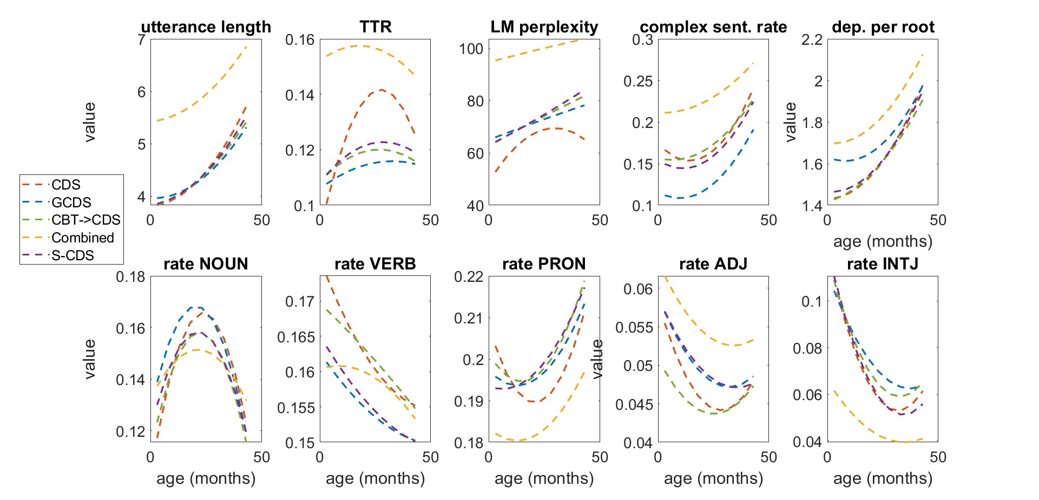
Results - Different training approaches

Slide 18
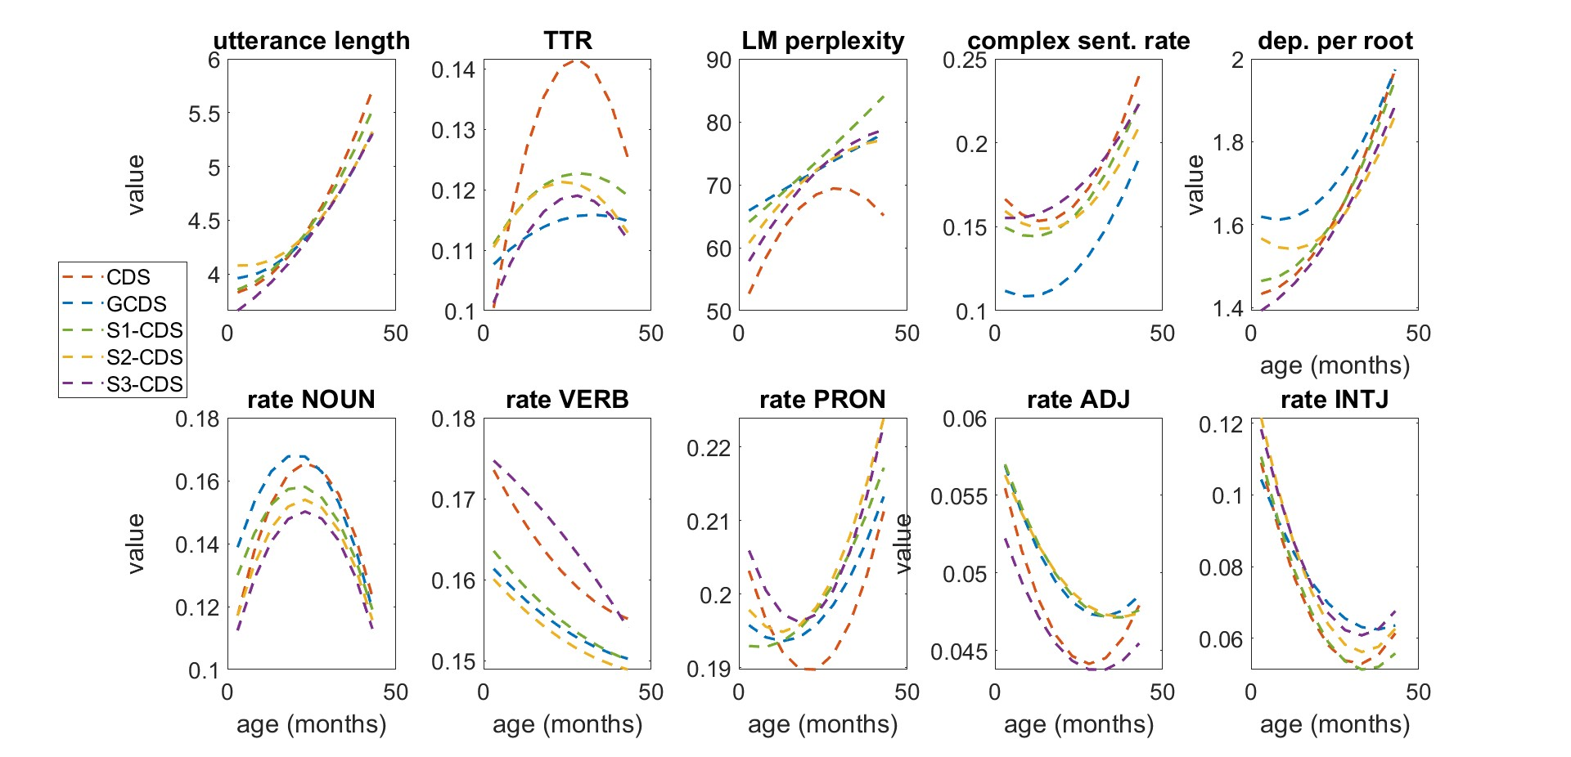
Results - Different style conditioning approaches

Slide 19
Summary of the results
Catastrophic forgetting in training first on one dataset and then on the other one
Cannot perform style-specific text generation with naïve joint training with both datasets
Use of style tokens allows the use of multiple sources of training data with style-specific text generation, also improves lexical diversity of the generated CDS.
All variants show no signs of overfitting: the generated language contents are new.

Slide 20
Further information
For checking out the thesis text and reviewing full result visit here:
https://trepo.tuni.fi/handle/10024/231681
For contacting me if you have any questions reach here:
shahmoradi.mina@gmail.com

Slide 21
References
Räsänen, O., & Kocharov, D. (2024). Age-dependent analysis and stochastic generation of child-directed speech. 45th Annual Meeting of the Cognitive Science Society (CogSci-2024). Cognitive Science Society. [1]
Huebner, P. A., Willits, J. A., Federmeier, K. D., & Sahakyan, L. (2021). Using lexical context to discover the noun category: Younger children have it easier. In J. Ross (Ed.), The psychology of learning and motivation (Vol. 75, pp. 279–331). Elsevier. [2]
Project Gutenberg (2018, July 12), https://www.gutenberg.org [3]
Devlin, J., Chang, M.-W., Lee, K., & Toutanova, K. (2019). BERT: Pre-training of deep bidirectional transformers for language understanding. arXiv preprint arXiv:1810.04805. [4]
Vaswani, A., Shazeer, N., Parmar, N., Uszkoreit, J., Jones, L., Gomez, A. N., Kaiser, Ł., & Polosukhin, I. (2017). Attention is all you need. In Advances in Neural Information Processing Systems (Vol. 30). Curran Associates, Inc. [5]
McCarthy, P., & Jarvis, S. (2007). vocd: A theoretical and empirical evaluation. Language Testing, 24(4), 459–488. [6]
Jelinek, F., Mercer, R. L., Bahl, L. R., & Baker, J. K. (1977). Perplexity—a measure of the difficulty of speech recognition tasks. The Journal of the Acoustical Society of America, 62. [7]

